Slide 1
Stock Analysis Report
Han Sun, M.A. Economics
2021/10/13

Slide 2
Outlines
1. Indicate Business Problem
2. Data Set, Explorative Data, Historical Analysis
2.1. Coding
3. Implementation
3.1. Cleaning & filtering
3.2. Feature generation
3.3. Review Model, apply Technical & Fundamental analysis
3.4. Upload/ Ready to visualize
4. Experiment, and Case Study
5. Future Work & Conclusion

Slide 3






Flow Diagram
Art Design
Visualization
Validation
Exploration
Pymysql
ODBC
Ingestion
Data Cleaning/ETL/Feature Generation

Slide 4

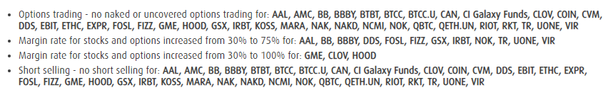
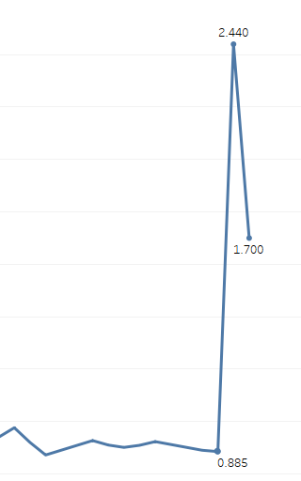
1. Purpose of this project
Market Surveillance (private investors: from reddit)
Detect pump and dump
Analysis in macroscopic
Usually target micro- and small-cap stocks
Buying, then selling heavily into a stock that trades on low volume

Slide 5
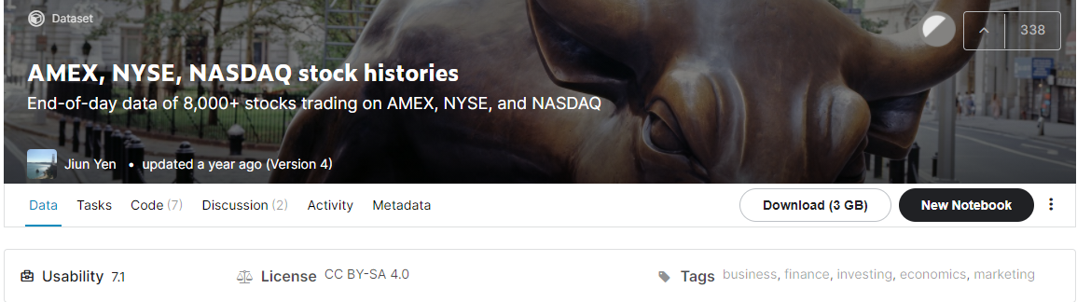
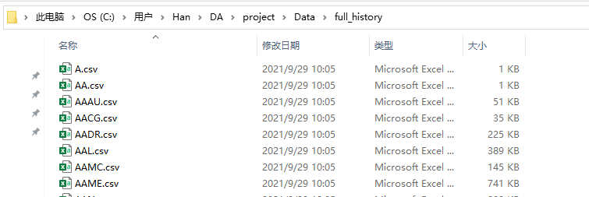
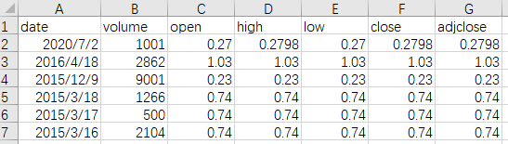
2. Data Exploration
Yahoo: https://www.kaggle.com/qks1lver/amex-nyse-nasdaq-stock-histories
Contains 8386 stock tickers
From 1980-2020
Missing Data

Slide 6
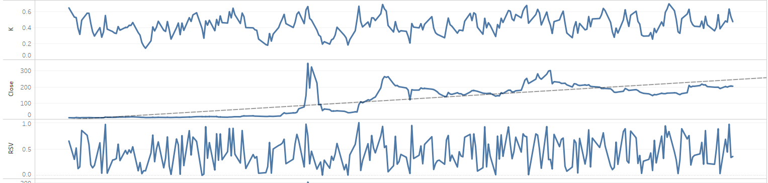
2.1. Historical Analysis & Coding
Thanks for Liu Weixin’s help
Tested & proven
i.i.d=Independent and identically distributed random variables
1. Flit volume excessed average (no correlation)
2. K value/ RSV (Relative Strength Index), Decomposition
Find guidelines ( support/ resistance)
Determine the alert.
Stationary process/ Stochastic
Apply time series analysis

Slide 7
3. Implementation
3.1. Cleaning & filtering
3.2. Common size analysis
Define a Percentage changes for each close ( will see next page)
3.3. Screening
Provide 3 different criterions (ARMA model gives 2 out of 3 criterion, another one provided by group members), meet all 3 criteria simultaneously returns a highest rank of alert. (will not include in this presentation)

Slide 8

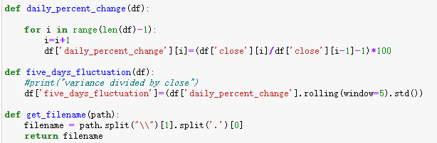
3.2. Feature generation
MA
Autoregressive Moving Average model
1st equation: regressing on it own lagged (AR)
2nd equation: residual term on 5 days period (MA)
AR

Slide 9
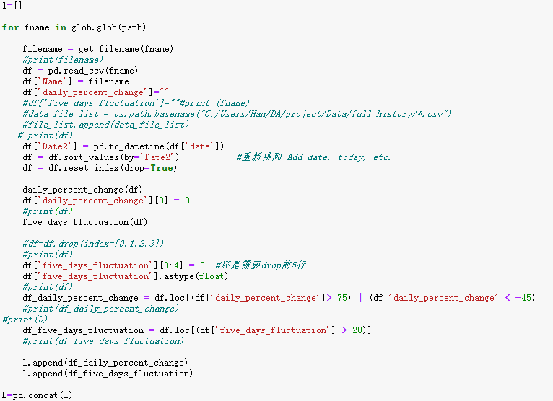
3.3. Review Model
Apply Upgrading data here

Slide 10
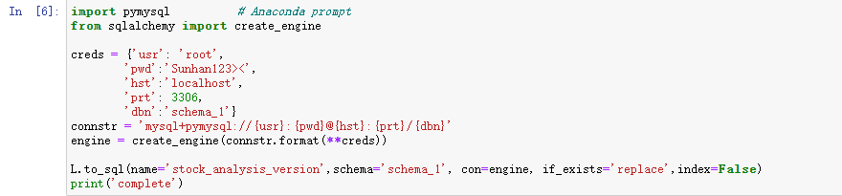
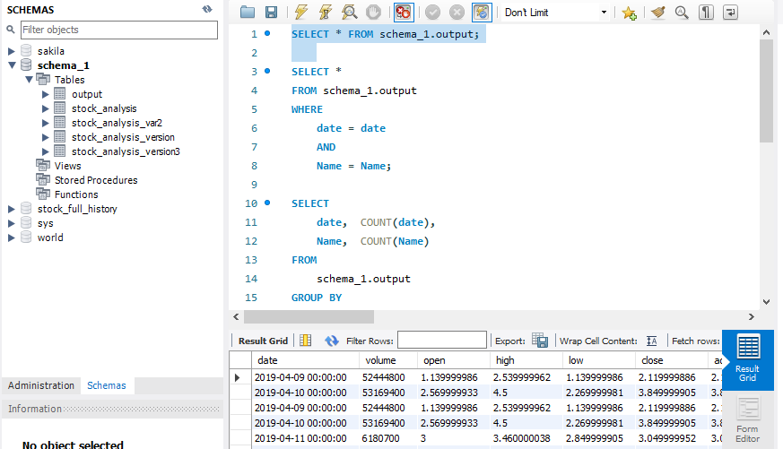
3.4. Upload/ Ready to visualize
append

Slide 11
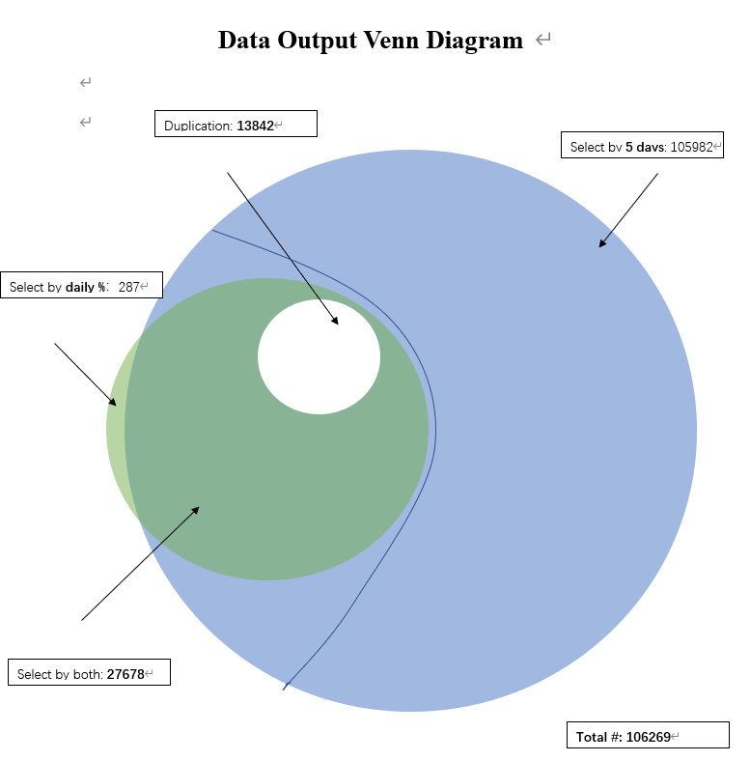
4. Experiment, and Case Study

Slide 12
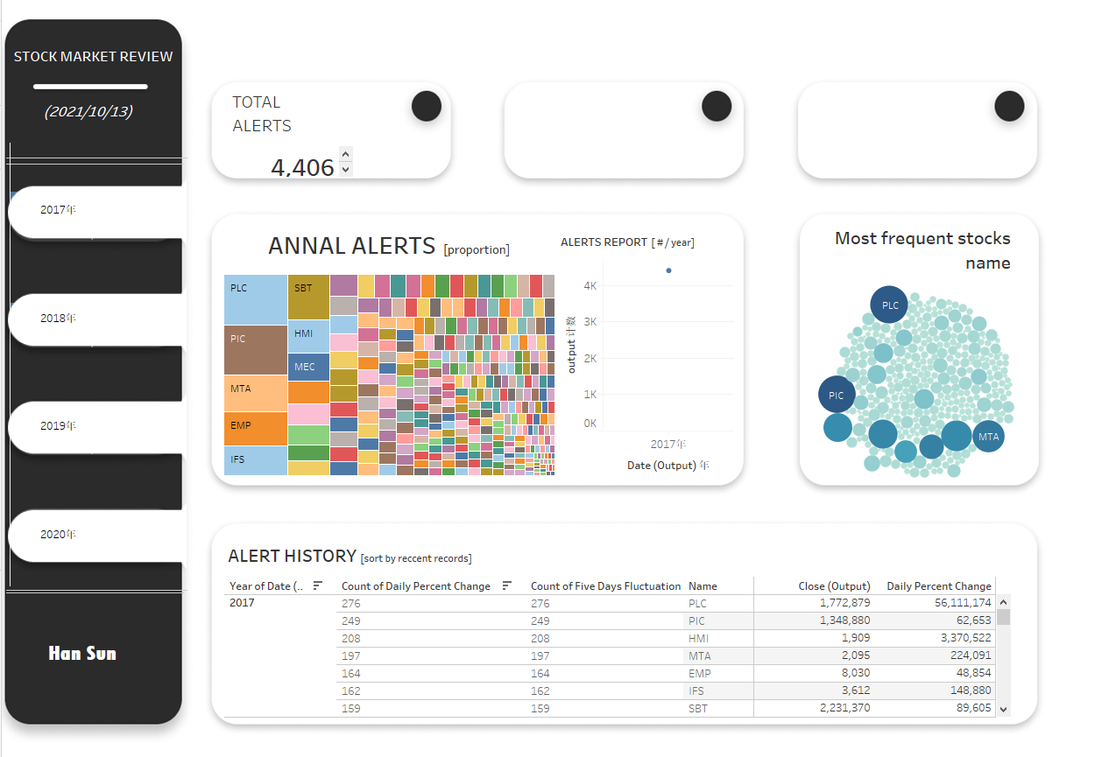
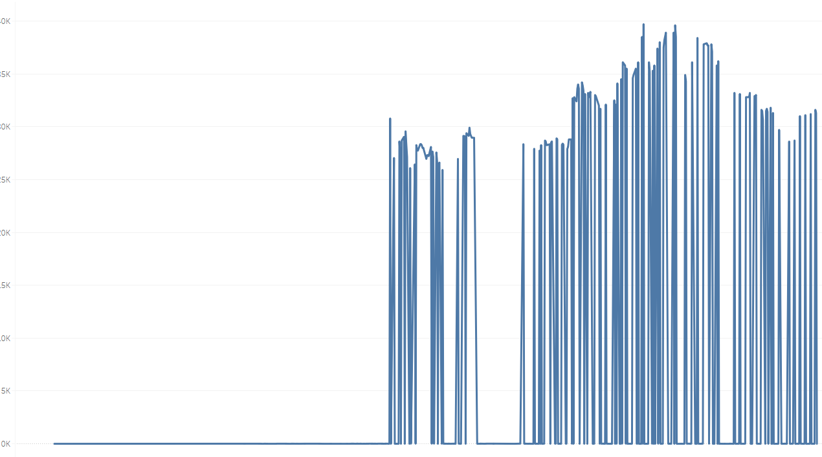
Continued- Tableau Dashboard (unfinished yet)
Stock: PLC

Slide 13
Continue- Important Results
*raising alerts: 0.4673% of overall datasets
*NASDAQ Composite has negative correlation with USD/CAD exchange rate for most of time, reverse under certain conditions (Heterogeneity).
*Top 3 years most fluctuation in stock market: 2020, 2008, 2009. i.e., Global financial crisis, and positive trends over time.

Slide 14



Future Work & Conclusion
Within one day change
Integration each ticker by industry (Build a Classification systems to compare industry trends and relative valuations among companies in a group)
ie. ICB/GICS

Slide 15
Reference
William Greene. 2017. “Econometric Analysis.” Chapter 21. ISBN-13: 9780134804576
John C. Alexander, Delbert Goff, and Pamela P. Peterson. 1989. “Profitability of a Trading Strategy Based on Unexpected Earnings.” Financial Analysts Journal, vol. 45, no. 4; 65–71. doi:10.2469/faj.v45.n4.65
Christopher Avery and Peter Zemsky. 1998. “Multi-Dimensional Uncertainty and Herding in Financial Markets.” American Economic Review, vol. 88, no. 4; 724–748.
Eugene F. Fama and G. William Schwert. 1977. “Asset Returns and Inflation.” Journal of Financial Economics, vol. 5, no. 2; 115–146. doi:10.1016/0304-405X(77)90014-9
Etc… (full list will available in my working paper)

